Slide 1


Slide 2
Covariance
Covariance is a measure of the association or dependence between two random variables X and Y . Covariance can be either positive or negative.
(Variance is always positive.)
Let X and Y be any random variables.
The covariance between X and Y is given by
cov(X, Y ) = E(XY ) − E(X)E(Y ),

Slide 3
cov(X, Y ) will be positive if large values of X tend to occur with large values of Y , and small values of X tend to occur with small values of Y .
For example, if X is height and Y is weight of a randomly selected person, we would expect cov(X, Y ) to be positive.
cov(X, Y ) will be negative if large values of X tend to occur with small values of Y , and small values of X tend to occur with large values of Y .
For example, if X is age of a randomly selected person, and Y is heart rate, we would expect X and Y to be negatively correlated (older people have slower heart rates).
If X and Y are independent, then there is no pattern between large values of X and large values of Y , so cov(X, Y ) = 0. However, cov(X, Y ) = 0 does NOT imply that X and Y are independent, unless X and Y are Normally distributed.

Slide 4
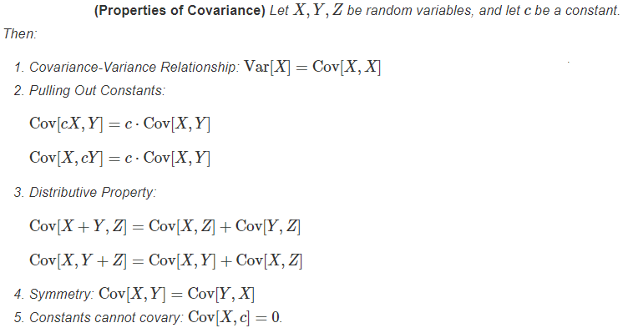

Slide 5
If Var(X + 2Y ) = 40 and Var(X − 2Y ) = 20, what is Cov(X, Y )?

Slide 7
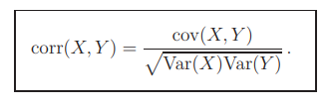
Correlation
The correlation coefficient of X and Y is a measure of the linear association between X and Y .
It is given by the covariance, scaled by the overall variability in X and Y .
As a result, the correlation coefficient is always between −1 and +1, so it is easily compared for different quantities.

Slide 8
Consider two random variables X and Y: - If ρ(X,Y)=0, we say that X and Y are uncorrelated. - If ρ(X,Y)>0, we say that X and Y are positively correlated. - If ρ(X,Y)<0, we say that X and Y are negatively correlated.

Slide 9
Find (a) the covariance, (b) the correlation coefficient of two random variables X and Y if E(X) = 2, E(Y) = 3, E(XY) = 10, E(X²) = 9, E(Y²) = 16.

Slide 10
If the covariance between x and y is 30, the variance of x is 25, and the variance of y is 144, find the correlation coefficient.

Slide 11
What is the correlation between x and a−x?

Slide 12
Suppose that X and Y are random variables with E(X) = 2 and E(Y) = 3, Var(X) = 4, Var(Y) = 5, and correlation coefficient ρ = 0.6. Let Z = −2X +4Y −3.
Find
(a) E(Z)
(b) Cov(X,Y)
(c) Var(Z)

Slide 13
Suppose that X and Y are random variables with Var(X) = 4, Var(Y) = 5, and Cov(X,Y) = −3. Calculate
Cov(12X −2013, 2014)
Cov(5X, 6Y)
Cov(X +2013, −Y +2014)
Cov(X +2Y, −3X +4Y)

Slide 14
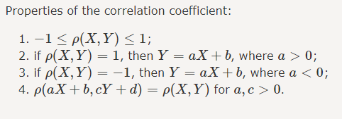

Slide 15
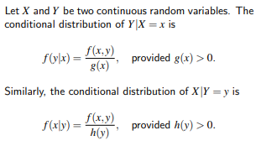
Conditional Probability Density Function (Conditional PDF)

Slide 16

Conditional Expectation
The conditional expectation of X, given that Y = y, is
E(X | Y = y) is the mean value of X, when Y is fixed at y.

Slide 17

What is the conditional expectation of Y given X?
Answer: 2/3

Slide 18

Conditional Variance
The conditional variance of X, given that Y = y, is
V(X | Y = y) is the variance of X, when Y is fixed at y.

Slide 19
What is the conditional variance of Y given X?

Slide 20
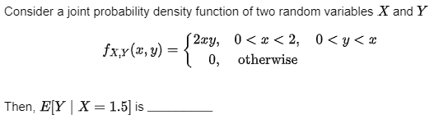
GATE DA 2024

Slide 21
GATE DA 2024
Two fair coins are tossed independently. X is a random variable that takes a value of 1 if both tosses are heads and 0 otherwise. Y is a random variable that takes a value of 1 if at least one of the tosses is heads and 0 otherwise.
The value of the covariance of X and Y is ______ (rounded off to three decimal places).
Answer: 0.0625

Slide 22
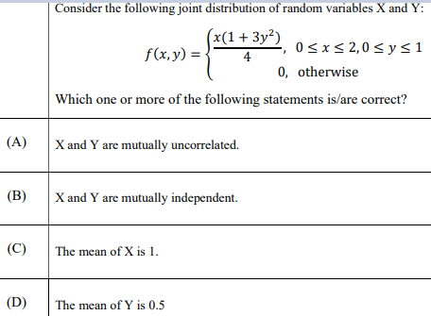
GATE DA Sample Paper 2024

Slide 24

Mean is average of a given set of data.
Let us consider example
2, 4, 4, 4, 5, 5, 7, 9
These eight data points have the mean (average) of 5:

Slide 25

Where μ is mean and x₁, x₂, x₃…., x_{i} are elements.
Also note that mean is sometimes denoted by $\overline{x}$

Slide 26
Median
The median is the middle value in dataset when arranged in increasing order.
Example : Cost = 20L, 30L,40L,1Cr

Slide 27
Mode
Mode is a value that appears most often.
(OR) In a frequency table which has maximum frequency.

Slide 28
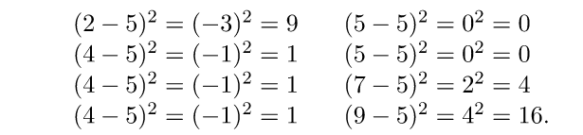

Variance is the sum of squares of differences between all numbers and means. Consider the data 2, 4, 4, 4, 5, 5, 7, 9 with mean 5.
First, calculate the deviations of each data point from the mean, and square the result of each:

Slide 29

Where μ is Mean, N is the total number of elements or frequency of distribution.

Slide 30
Standard Deviation is square root of variance. It is a measure of the extent to which data varies from the mean.
Consider the data 2, 4, 4, 4, 5, 5, 7, 9 with mean 5 and variance 4.
Standard Deviation (for above data) = sqrt(4) = 2

Slide 31
GATE CS 2012
Which of the following assertions are CORRECT? P: Adding 7 to each entry in a list adds 7 to the mean of the list Q: Adding 7 to each entry in a list adds 7 to the standard deviation of the list R: Doubling each entry in a list doubles the mean of the list S: Doubling each entry in a list leaves the standard deviation of the list unchanged (A) P, Q (B) Q, R (C) P, R (D) R, S

Slide 32

Uniform Discrete Distribution

Slide 33
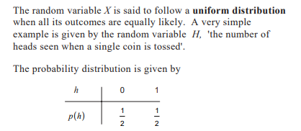

Slide 34
Example:
The event of rolling a die can be represented by a discrete random variable with the probability distribution being such that each event has a probability of 1/6

Slide 35


Slide 36

Expectation and Variance of uniform Discrete Distribution

Slide 37
Bernoulli Distribution
Bernoulli trial — a random experiment that has only two outcomes (usually called a “Success” or a “Failure”).
Getting a heads.
Getting a six on dice.
Getting two heads when we toss two coin simultaneously.

Slide 38
In an experiment whose outcome can be classified as either a success or failure.
Let (X=1) if the outcome is success and (X = 0) if it is a failure,
The probability mass function is given by
P(0) = P(X = 0) = 1-p
P(1) = P(X = 1) = p , where p is the probability of success.
X is Bernoulli random variable.

Slide 39
Example : A basketball player can shoot a ball into the basket with a probability of 0.6. What is the probability that he misses the shot?

Slide 40
Expectation and Variance of Bernoulli Distribution
E[X] = p
$$\left.V[X]=p(1−p\right)$$

Slide 41

Thank you

